Slide 1

Minor Project II on Comparative Study and Analysis of Uninformed Search Algorithms
NAME | ENROLLMENT NO. | BRANCH
Raghvendra Singh | R134218128 | CSE-CSF
Srajan Jaiswal | R134218170 | CSE-CSF
Amandeep Singh | R134218203 | CSE-CSF
Aman Saraogi | R134218204 | CSE-CSF
Under the guidance of : Dr. Manoj Kumar

Slide 2
INTRODUCTION
Addressing the aspect of a problem-solving approach, one is under a particular situation and wants to be in the desired situation, so what comes out as the task is to make a series of decisions or the series of moves that will transform the given situation into the desired situation.
A search can be performed in many different spaces as the given state and the goal state likewise, several other states lying in between the two, the given and the goal state.
Search is performed over the state spaces to end up at the desired solution when the series of decision is not known. There are two types of state-space searches, informed search and uninformed search.
Area of interest of this project lies around uninformed search under state-space search, which is also known as Blind search as it is unaware of the search space and can only distinguish between a goal state or a non-goal state.
Various algorithms come under uninformed searches like Breadth First Search, Depth First Search, Depth-Limited Search, Depth First Iterative Deepening Search, Random Walks, and Bidirectional Search. This Project takes into consideration, four major algorithms that are Breadth First Search, Depth First Search, Depth-Limited Search, and Depth First search with Iterative Deepening.

Slide 3
OBJECTIVE
To perform a comparative study of different performance parameters in Uninformed Search Algorithms listed below to identify and implement the best search approach under different parametric conditions.
1. Breadth First Search
2. Depth First Search
3. Depth-Limited Search
4. Iterative Deepening Depth First Search

Slide 4
PROBLEM STATEMENT
Searching is carried out to retrieve information stored within the massive data structures, here efficiency becomes a major issue. There exist certain problems which tend to hinder the efficiency of the search algorithms which are taken under consideration in this project.
These Problems are: -
The searching of a node in DFS algorithm works well but when the target lies on the right side of the tree the result will not be optimal.
The searching of a node in the BFS algorithm overcomes the problem faced in the DFS algorithm but its memory consumption is much greater than DFS.
The searching of a node in DLS algorithm overcomes the problem which is faced in both DFS and BFS algorithm by introducing a limit on the level of search but to find that limit the tree should be solved manually.

Slide 5
APPLICATION OF DFS ARE:
Detecting cycle in a graph :
A graph has a cycle if and only if we see a back edge during DFS. So we can run DFS for the graph and check for back edges.
To test if a graph is bipartite
We can augment either BFS or DFS when we first discover a new vertex, color it opposited its parents, and for each other edge, check it doesn’t link two vertices of the same color. The first vertex in any connected component can be red or black!
Finding Strongly Connected Components of a graph:
A directed graph is called strongly connected if there is a path from each vertex in the graph to every other vertex.
Path Finding:
We can specialize in the DFS algorithm to search a path between two vertices.

Slide 6
APPLICATION OF BFS
Web Crawlers in Search Engines:
It helps us to find the particular topic from the source page and follow all links from the source and keep doing the same up to the required depth.
GPS Navigation systems:
GPS Navigation systems use Breadth-First Search I to find all neighbouring locations.
Broadcasting in Network:
In networks, a broadcasted packet follows Breadth-First Search to reach all nodes. Thus reduces transmission delay and saves battery power.
Finding Shortest Path in the unweighted graph:
In an unweighted graph, the shortest path is the path with the least number of edges. With Breadth-First, we always reach a vertex from a given source using a minimum number of edges.

Slide 7
APPLICATION OF IDDFS ARE:
IDDFS uses to solve tree game problem like:
8 Puzzle Problem
8 Queen Problem
Tic-tac-toe

Slide 8
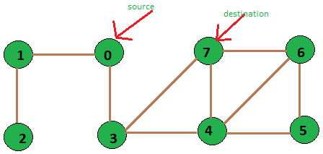
DEPTH FIRST SEARCH
Depth First Search is a simple search algorithm based on stack implementation.
This starts traversing from root explores a path all the way to leaf before backtracking and exploring another path.
The solution is not optimal in many of the cases.

Slide 9
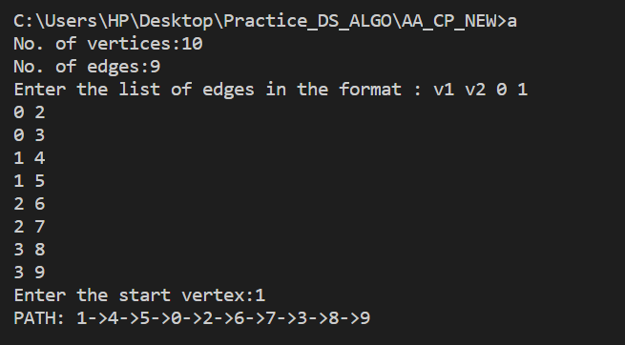
OUTPUT:

Slide 10
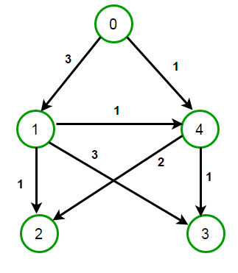
BREADTH FIRST SEARCH
Breadth First Search is a simple search algorithm based on queue implementation with different logic than depth first search.
This traverses the graph depth by depth. It starts traversing from root explores the neighbor nodes first, before moving to the next node.
It is complete in nature and gives us the optimal solution. It consumes more memory than depth first search.

Slide 11
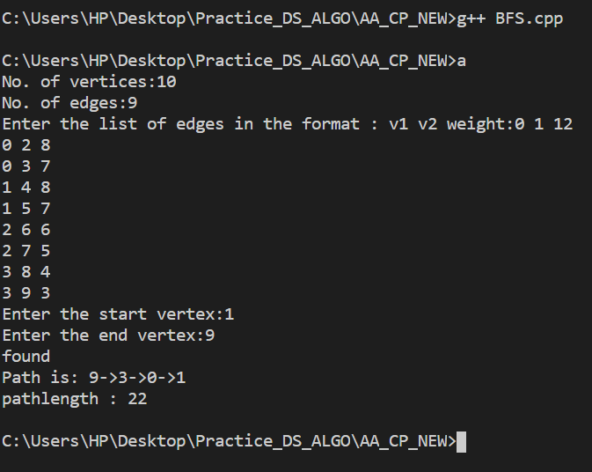
OUTPUT:

Slide 12
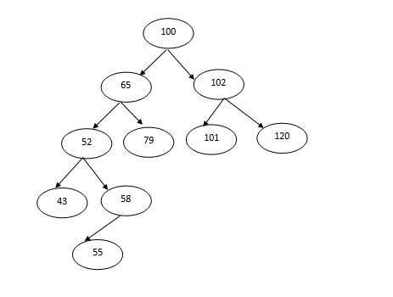
DEPTH LIMIT SEARCH
Depth limit search algorithm is an extension of depth first search.
This algorithm is implemented in a similar way of depth first search with a slight difference which is, this will be asking the level of the tree along with the destination.
With introducing level, it limits the number of comparisons in a tree which is given in limit.

Slide 13
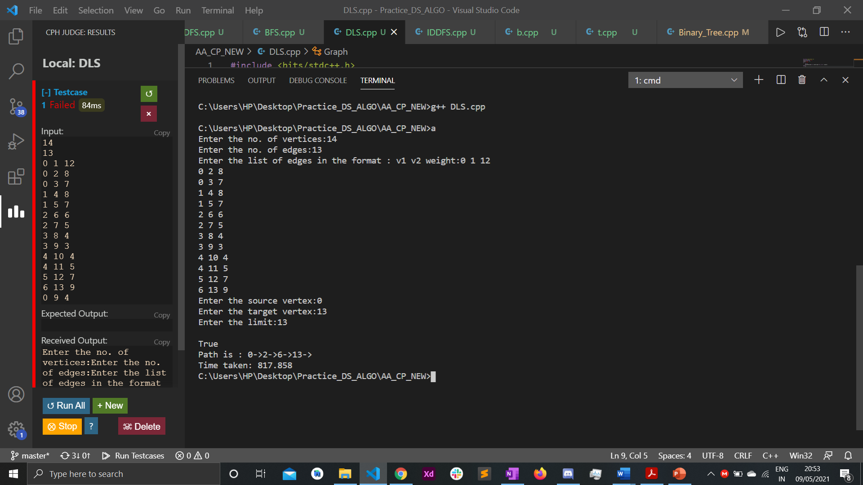
OUTPUT:

Slide 14
ITERATIVE DEEPENING
DEPTH FIRST SEARCH
Iterative deepening depth first search is a combination of depth first search and breadth-first search.
It selects the benefits of both the algorithms and gives out the best solution compared to previous algorithms.

Slide 15
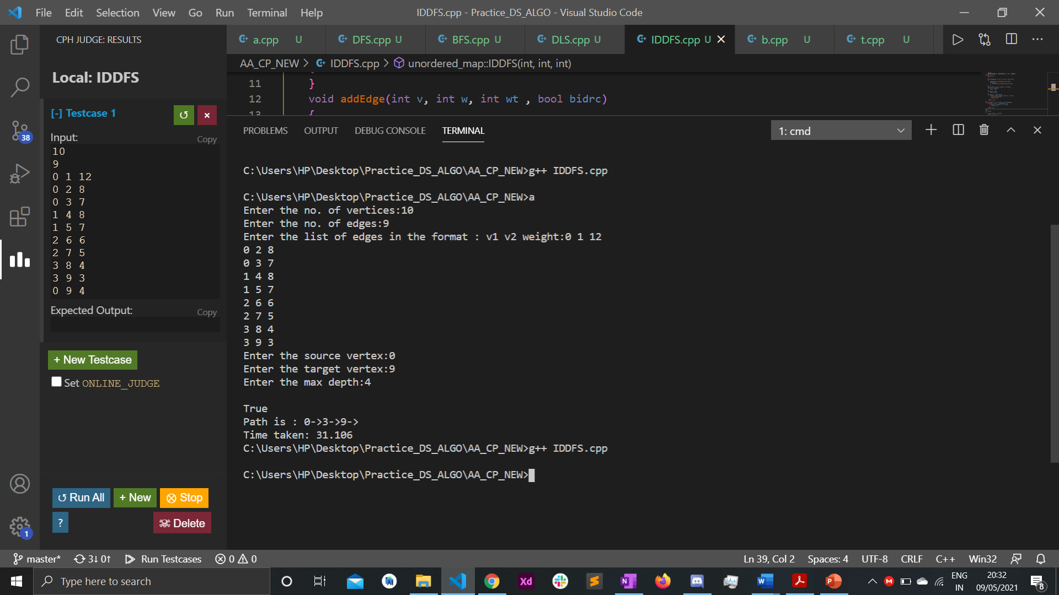
OUTPUT:

Slide 16
METHODOLOGY
Literature Review.
Detailed study of different search algorithms under Uninformed Search.
Detailed study of the selected Optimization algorithm.
Designing process of flow diagram and algorithms
Development and Implementation.
Testing
Comparative analysis of algorithms on different environments like x64 bit.
Report writing

Slide 17
RESULT ANALYSIS
Case 1 :-
When the search algorithms are executed in x64 bits of window os, the first set of the result are obtained.
For the total 10 entered values if the value to be searched is ‘9’ the time taken by respective algorithm decreases as we move from BFS to DLS to DFS and finally to IDDFS.

Slide 18
RESULT ANALYSIS
Case 2 :-
When the same search algorithms are executed in x32 bits of windows the second set of the result are obtained. For the total 10 entered values if the value to be searched is same as case 1 i.e. ‘9’ to provide the same parameter the time taken by respective algorithm again decreases as we move from BFS to DFS.

Slide 19
CONCLUSION
We achieved optimization from Depth-First search to Iterative Deepening Depth-First search while taking consideration each algorithm time complexities and found the minimum time search algorithm.
This algorithm can be used in many places like: -
The algorithm can be used effectively for crawlers in the search engine.
The algorithm can also be applied in peer to peer networks (Minimum spanning tree).
They can be used for Broadcasting in networks.
The algorithm can be used for social websites and GPS systems.

Slide 20
REFERENCES
https://www.geeksforgeeks.org/graph-and-its-representations/
https://www.geeksforgeeks.org/breadth-first-search-or-bfs-for-a-graph/
https://www.geeksforgeeks.org/iterative-deepening-searchids-iterative-deepening-depth-first-searchiddfs/
https://www.geeksforgeeks.org/applications-of-depth-first-search/
http://theoryofprogramming.com/2018/01/14/iterative-deepening-depth-first-search-iddfs/

Slide 21
THANK YOU!!

